Slide 1
Educator Externship
AT OCHSNER’S MARKETING DIVISION

Slide 2
About
Ochsner’s network of hospitals consists of 40 owned, managed and affiliated hospitals and speciality hospitals and more than 100 health care centers and urgent care centers across the region.
The President and CEO view the organization and the brand identity as one.
Louisiana’s largest non-profit, academic, healthcare system.

Slide 3
Marketing & Communication
The Marketing & Communication Division is in the process of being restructured to meet the organization’s needs.
Who is marketing and communication?
Ochsner brand
Marketing
Digital content and creative media
Internal communication
Public relations
Retail
Division at Ochsner

Slide 4
Key Takeaways + Insights

Slide 5
Client Focused
The division is similar to an agency, but internal service lines are treated like clients
PRIMARY CARE
WOMEN SERVICES
WOMEN SERVICES
Who the Marketing & Communication Division serves
HEART & VASCULAR
CANCER SERVICES
DIGESTIVE DISORDERS
PEDIATR-
ICS
SPORTS MEDICINE
NEURO-
SCIENCES

Slide 6
Data Driven
Client requests a campaign
MARKETING & COMMUNICATION DIVISION
Identifies the demographics of the target audience
Determines where to find those people
Develop a strategy
Data influences creative.
Content creation
Campaign optimization

Slide 7
24,000 different ads created
50,000 different keywords purchased
For a single 2 month campaign for one client

Slide 8
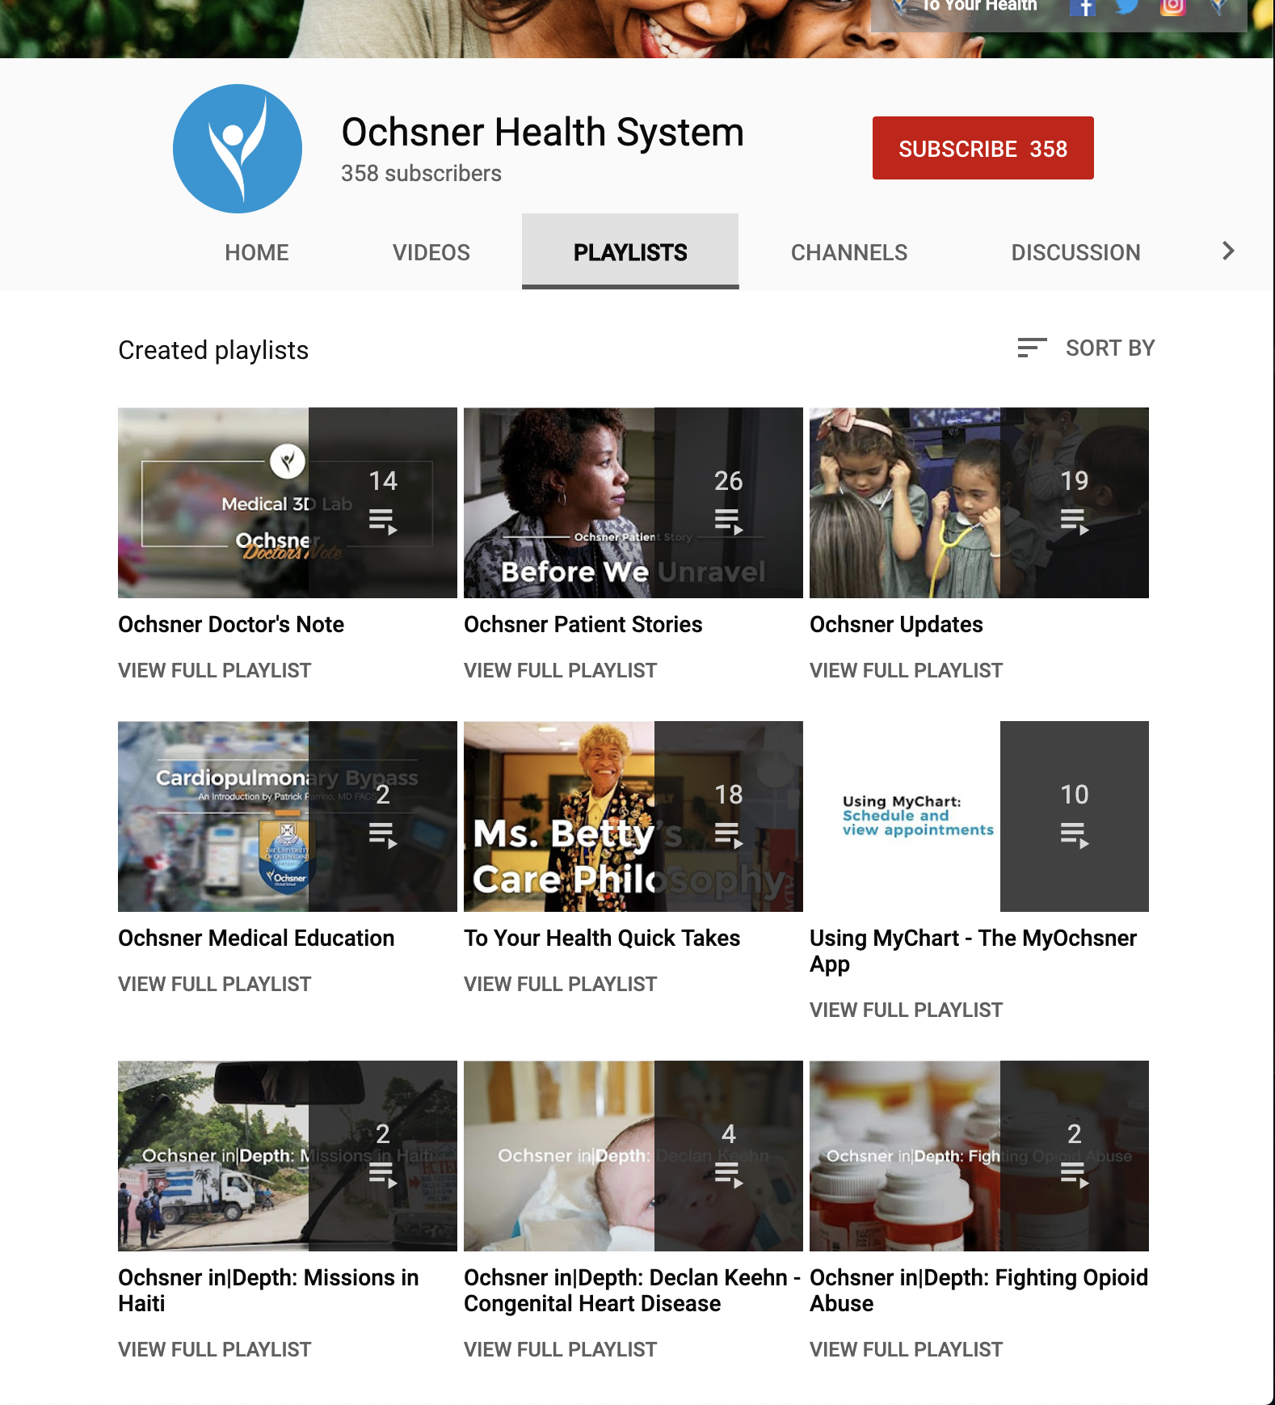
Storytelling
Ochsner’s approach to content
Notes:
Prefer documentary style shooting and editing to tell patient stories.
Social media, digital media (for web and blog), and creative media are all separate.
Rather than promote a physician, team, or service, Ochsner shares patient stories. This approach uses empathy and personal connections to promote the networks services and facilities.

Slide 9
Curriculum Development

Slide 10
Skill Building
TECHNICAL SKILLS
While the marketing division is growing, it is important to have the skills to execute all parts of content creation including:
Having a vision and pre-production
Production
Post-Production
Publication
SOFT SKILLS
Are more valuable than technical skills.
Work with different audiences
Build relationships
Time management
Accountability
Communication
Being polite
Flexibility
A willingness to learn

